Slide 1

Chi-square Datasets Analysis
Presented by- Prachi Waghmare

Slide 2
Introduction
The analysis consists of 5 datasets which have been joined and relationship has been created between the fields.
I have used Tableau Visualization tool in order to create the dashboard and sheets. This is an interactive dashboard with various filters and actions applied to it.
The datasets consists of information about sports betting activities and details of the players involved along with their transactions.
I have interpreted and cleaned the data and analyzed the KPIs which can be useful to get insight from the given datasets.
Techniques used-
Data Interpretation
Data Cleaning
Data Modelling
Inner joined tables using Player ID as the common field
Built data driven metrics
Created visuals using in-built graphs and design of the tool

Slide 3
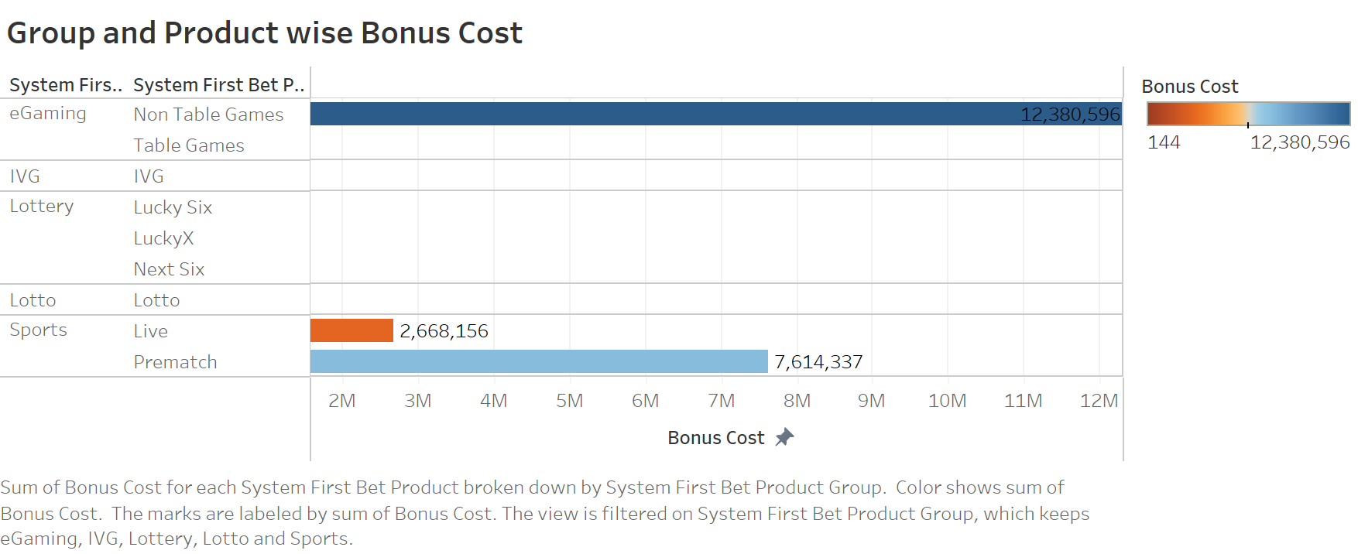
KPI 1
This bar graph shows us the Bonus cost for each product and there sub product.
We can observe that eGaming product for Non Table Games has the highest Bonus Cost which is about 12 M as compared to other products.
Products like IVG, Lottery and Lotto needs to promoted more to generate some numbers.

Slide 4
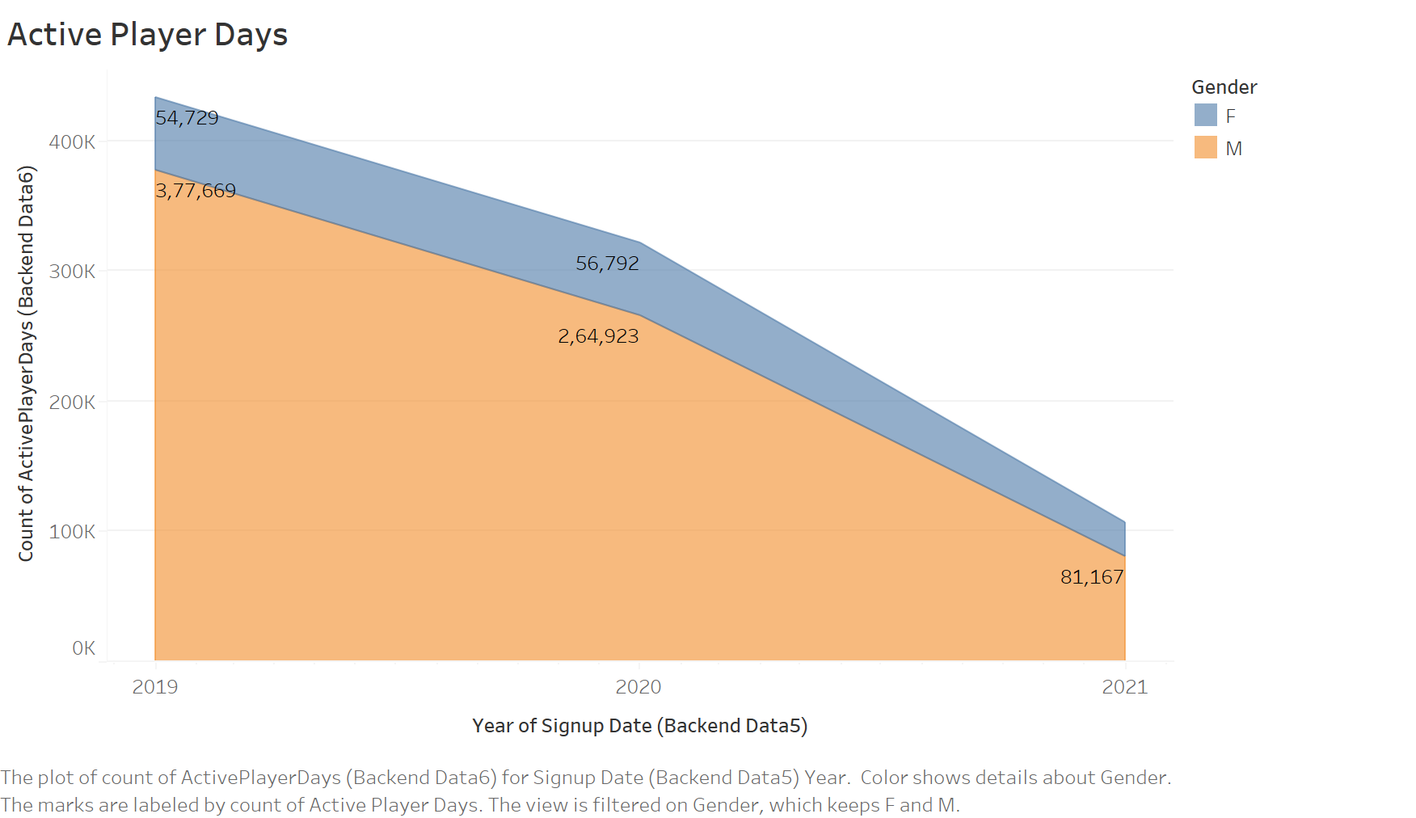
KPI 2
Here we have a count of active player days for both Male and Female depicted through an Area Chart.
It was observed that the count of active days for male was 378K in the year 2019 which has recorded highest all and has decremented in the consecutive years.
For females this score has been around 55K in 2019, which decreases in the following years.
In order to increase the count for both Male and Female categories, exciting offers like discounts and winning prize can be introduced.

Slide 5
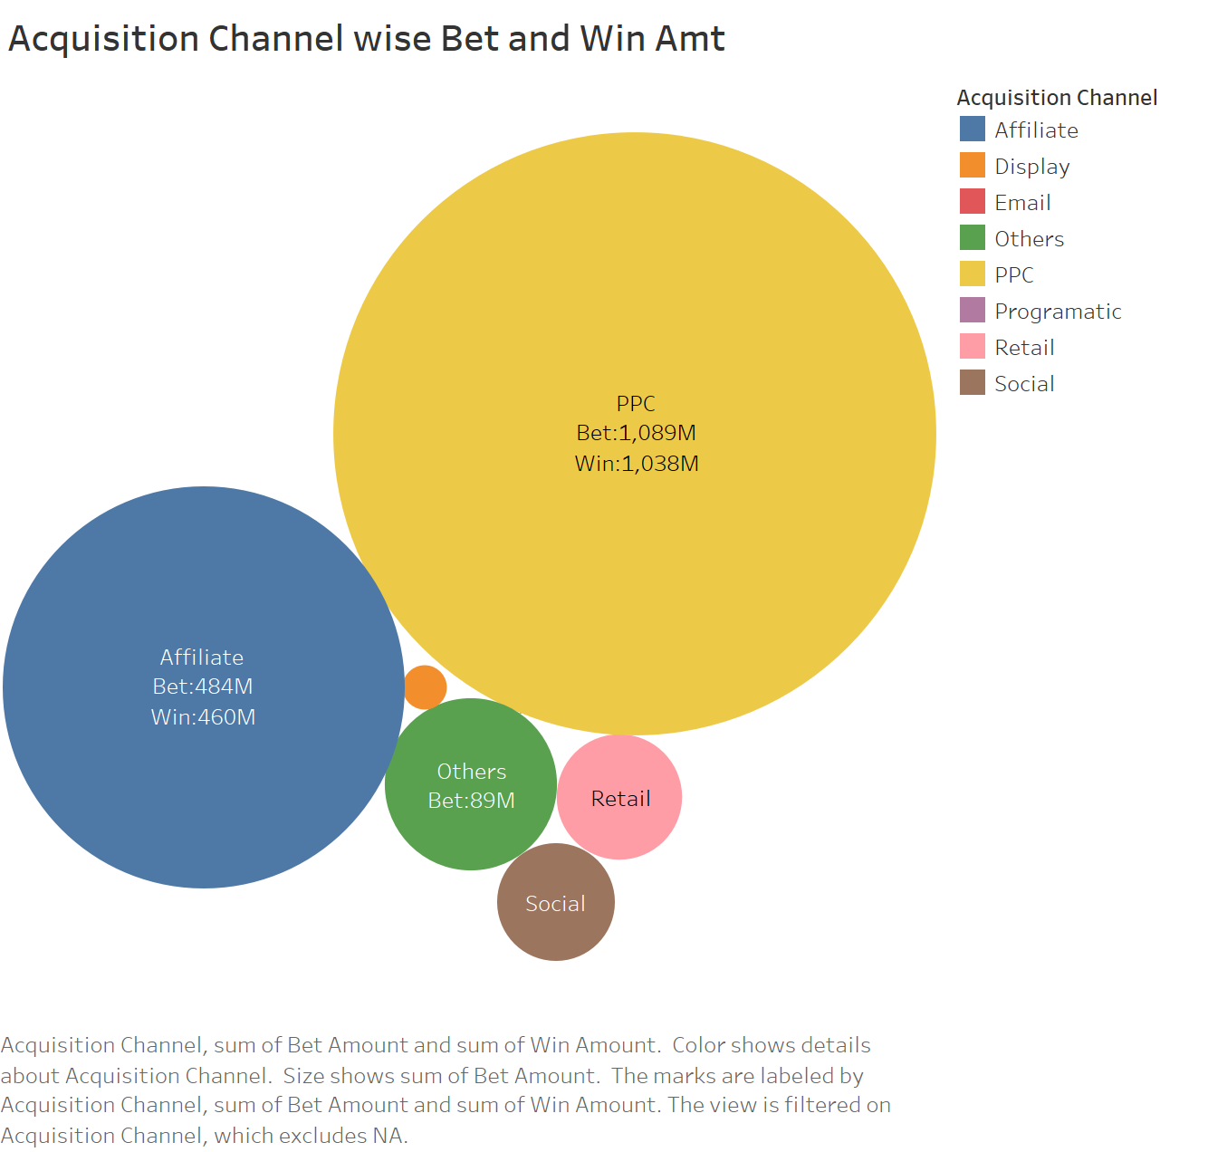
KPI 3
In order to find the Bet and Win amount for different Acquisition Channels, I have visualized a packed bubble chart.
It is visible that channel PPC has received highest Bet and win amount which is around 1089M and 1038M respectively.
The amount has been lowest for Display channel.
A strong acquisition strategy needs to made to increase the collaboration on all the channels.

Slide 6
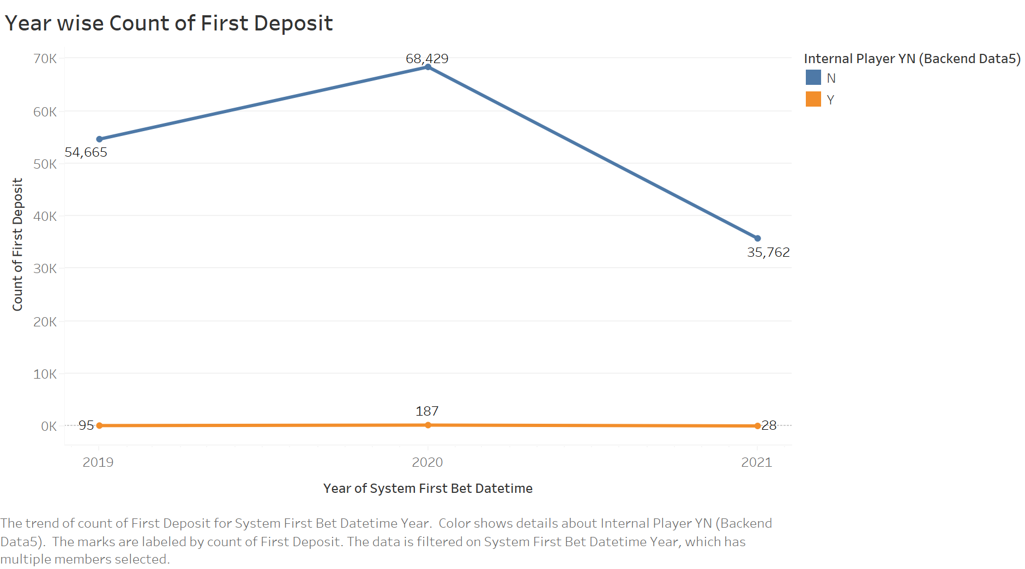
KPI 4
Through the above Line Chart we can see that external players have maximum count of First Deposit as compared to internal players.
In the year 2020 the count has been the highest.

Slide 7
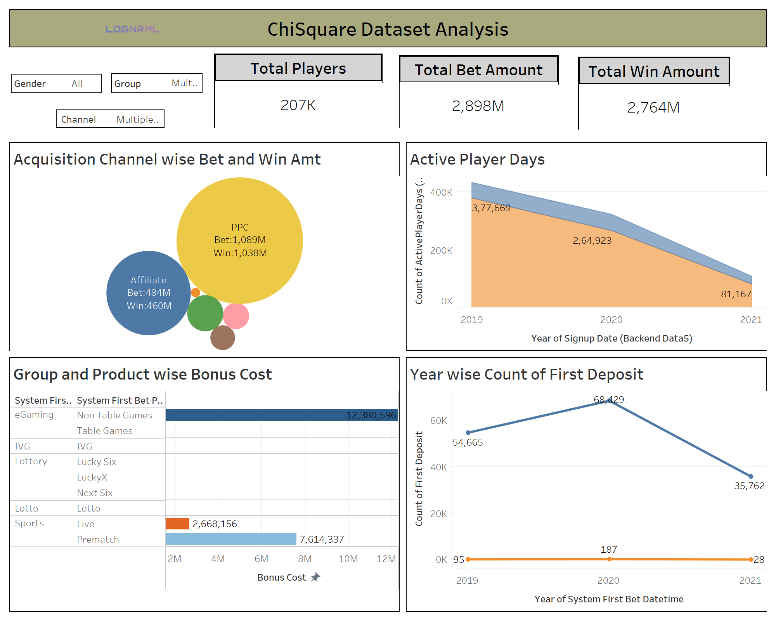

Slide 8
Dashboard
The dashboard contains a collection of all the views for the KPIs mentioned.
I have created 3 row cards for total number of players, Bet amount and Win amount.
There are filters applied on the visuals for all the sheets with related fields.
Some correlated actions like Highlight, Filters and Links from one sheet, applied to all other sheets.

Slide 9
THANK YOU !
Prachi Waghmare
Email: prachiti96@gmail.com

